Slide 1

Washoe County Board of Adjustment
August 2, 2018

Slide 2
Project Request
A Special Use Permit to allow for the expansion of a Heavy Industrial use within the Industrial zone.
Heavy Industrial use has occurred onsite since 1967.
Actual use is custom manufacturing of aerospace engine components.
Proposed to expand building space by 109,470 square feet. Existing space is 134,000 square feet.

Slide 3
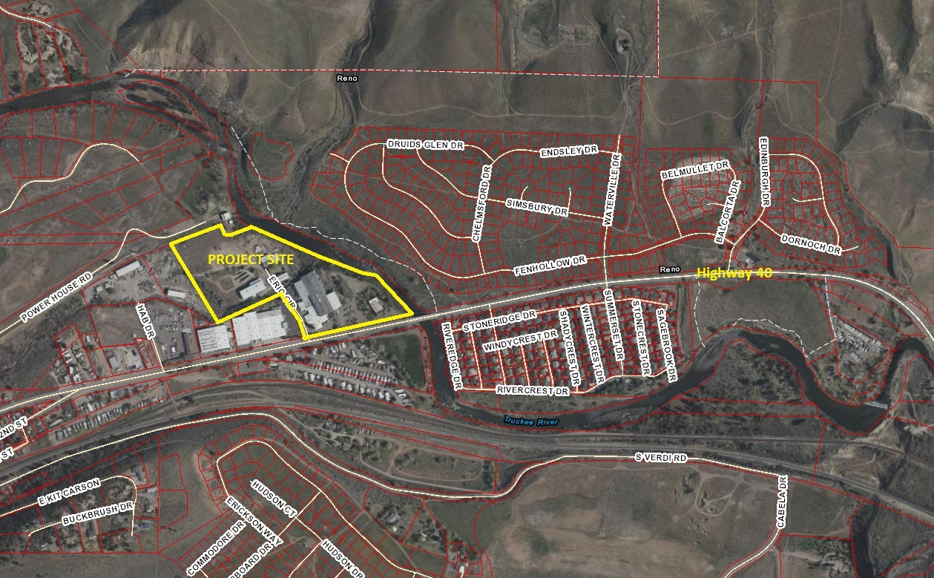
Project Location

Slide 4
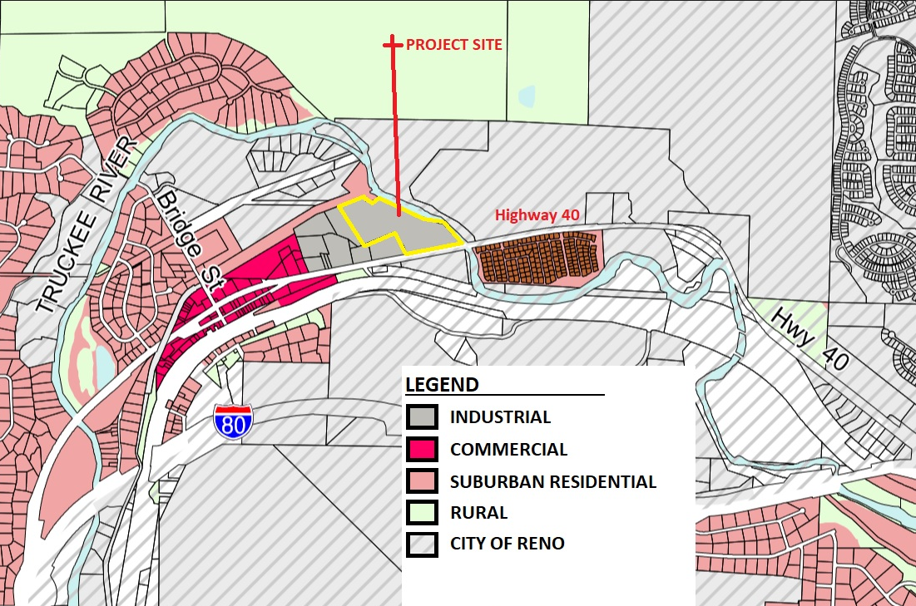
Master Plan

Slide 5
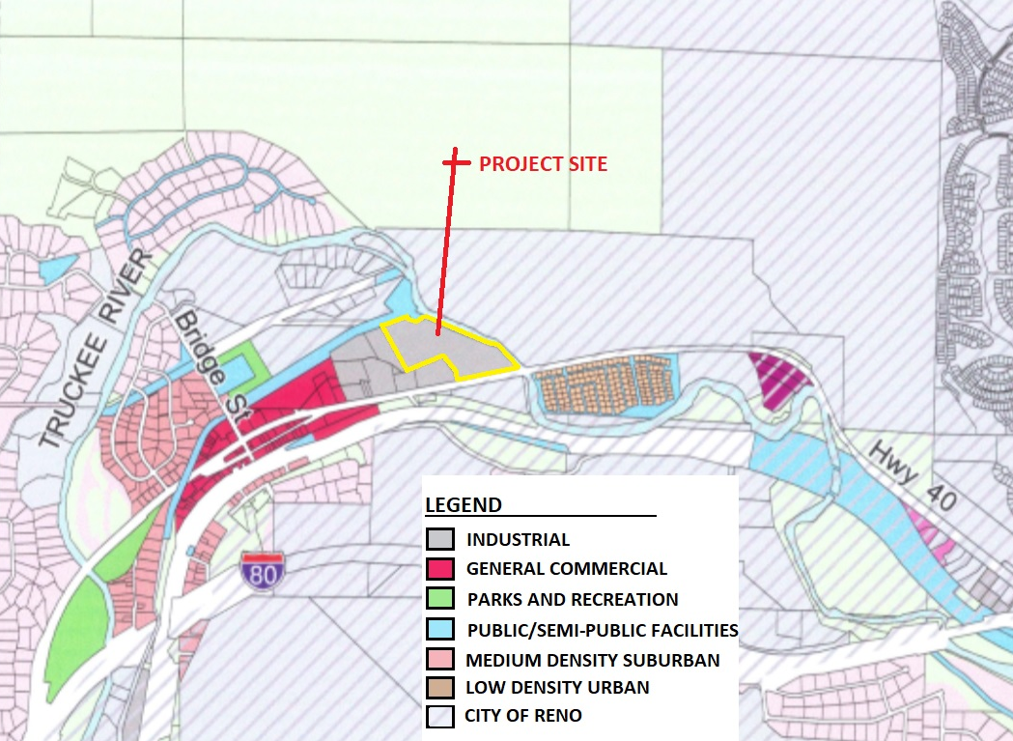
Zoning

Slide 6
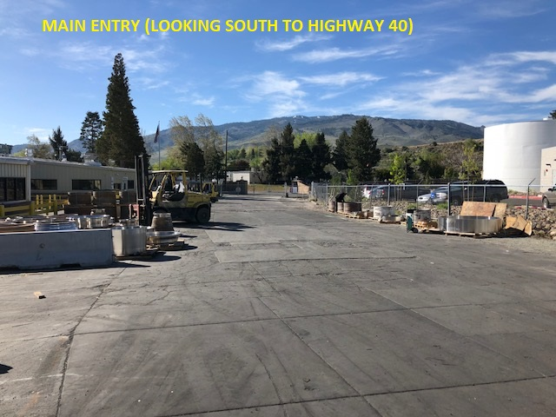
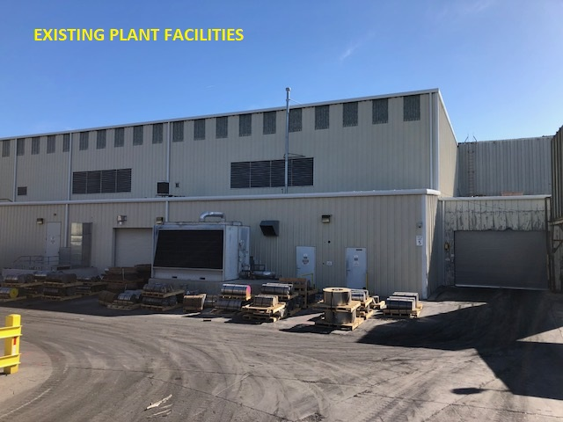
Site Photos

Slide 7
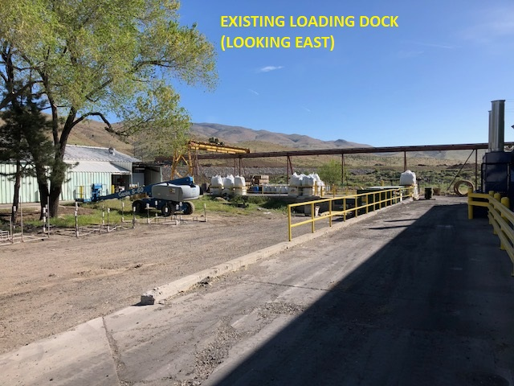
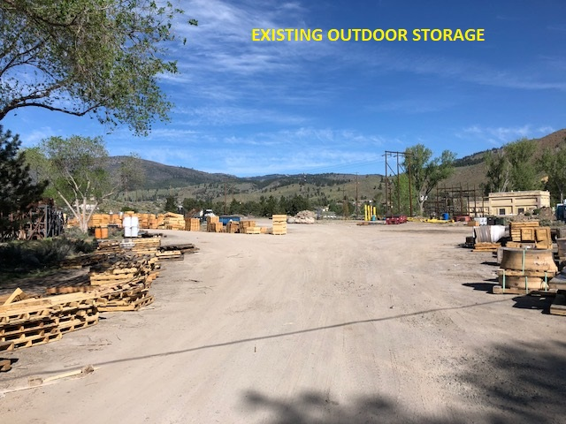
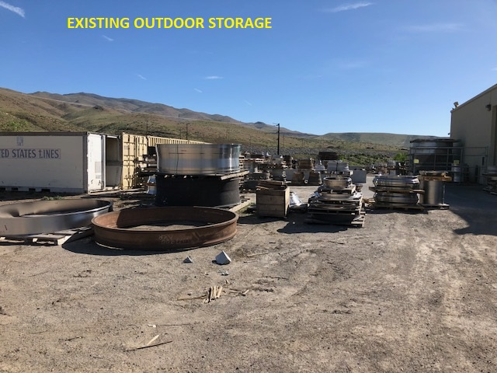
Site Photos

Slide 8
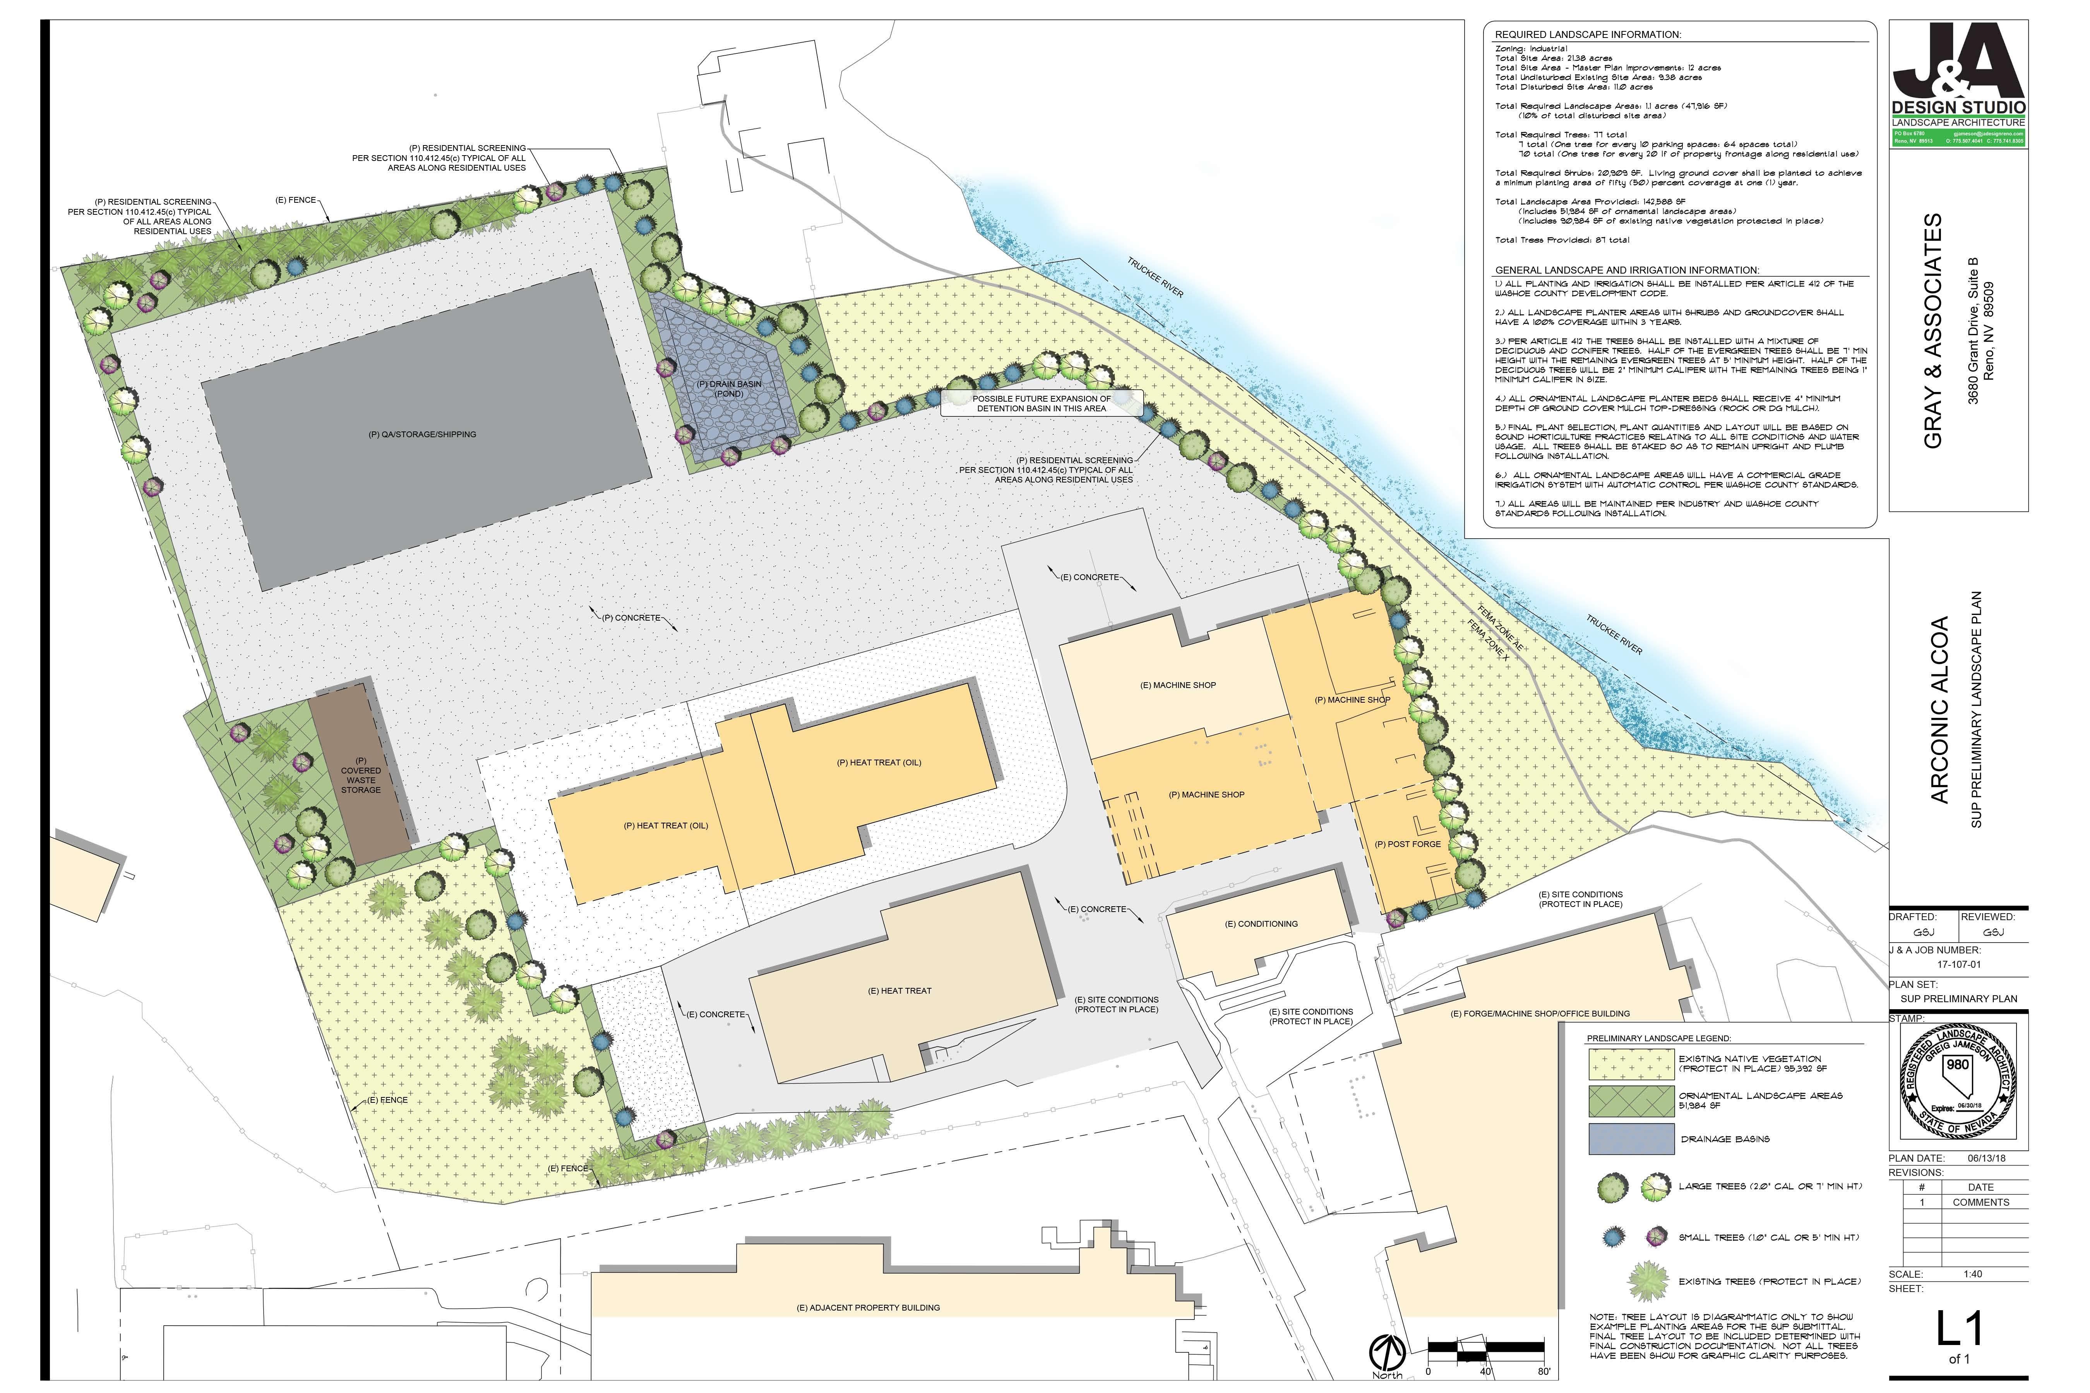

Slide 9
Public Outreach
The project was presented to the CAB in June.
-revisions to existing site lighting
-improved noise control on specific operation (RW125-3000 1399 radial axial rolling mill)
Open House event held after CAB meeting. Interested public were invited to tour the site and discuss operations with staff.

Slide 10
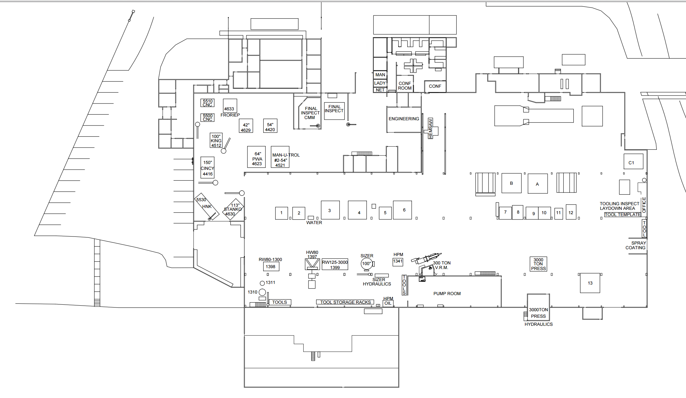
Noise Study
61.2dB
61.0dB
61.0dB
66.0dB
61.8dB
64.2dB

Slide 11
Noise Impacts
Operation conforms to noise code.
Noise studies are routinely conducted to ensure safe site conditions.
Arconic agrees to upgrade building insulation and to keep shop door closed before 9am.

Slide 12
Conditions of Approval: Noise
Condition O.VI (Conditions of Approval p. 3) reads: Forging Operations shall maintain a normalized schedule between the hours of 6:00am and 6:00pm.
Proposed amended condition: Forging operations on the RW125-3000 1399 radial axial rolling mill shall maintain a normalized schedule between the hours of 6:00am and 6:00pm.

